Slide 1

Team Raptors
Unit testing with C#
Anurag Kumar | Keerthi Sree Kukunoor | Meghana Putta |
Nilantha Dambadeniya | Ujjawal Kumar
Notes:
© Copyright Showeet.com – Creative & Free PowerPoint Templates

Slide 2





Team Members
Ujjawal Kumar
Nilantha Dambadeniya
Anurag Kumar
Keerthi sree Kukunoor
Meghana Putta
Notes:
© Copyright Showeet.com – Creative & Free PowerPoint Templates

Slide 3
Outline
01
Introduction
05
Code coverage
02
Use of unit testing
06
Continuous integration
03
07
Summary
Advantages & disadvantages of unit testing
04
08
Demonstration
Unit testing frameworks
Notes:
© Copyright Showeet.com – Creative & Free PowerPoint Templates

Slide 4
Introduction
Unit testing can increase confidence and certainty in changing and maintaining code in the development process
Unit testing always has the ability to find problems in early stages in the development cycle
Codes are more reusable, reliable and clean
Development becomes faster
Easy to automate
Notes:
© Copyright Showeet.com – Creative & Free PowerPoint Templates

Slide 5
Use of Unit Testing
5
Notes:
© Copyright Showeet.com – Creative & Free PowerPoint Templates

Slide 6
What is Unit Testing?
Unit testing involves breaking your program into pieces, and subjecting each piece to a series of tests
Usually tests are run as separate programs, but the method of testing varies, depending on the language, and type of software (GUI, command-line, library)
Most languages have unit testing frameworks, you should look into one for yours
Tests are usually run periodically, often after every change to the source code. The more often the better, because the sooner you will catch problems
Notes:
© Copyright Showeet.com – Creative & Free PowerPoint Templates

Slide 7
Why we do Unit testing?
Makes the Process Agile
Quality of Code
Finds Software Bugs Early
Facilitates Changes and Simplifies Integration
Provides Documentation
Debugging Process
Design
Reduce Costs
Notes:
© Copyright Showeet.com – Creative & Free PowerPoint Templates

Slide 8
Advantages & disadvantages of Unit Testing
8
Notes:
© Copyright Showeet.com – Creative & Free PowerPoint Templates

Slide 9
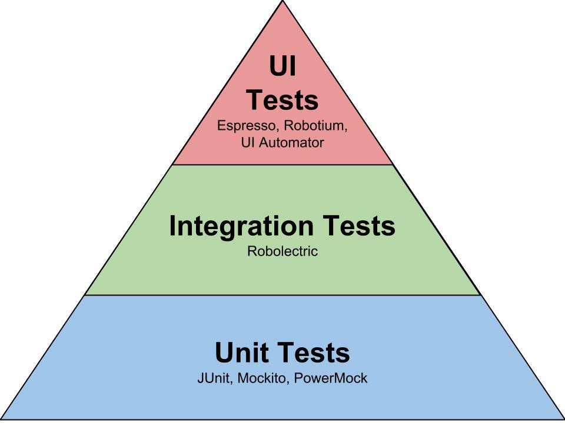
Advantages of Unit Testing
Early Detection/Bugs Prevention
Improves Teamwork
Inspires Confidence and is Fun
Time and Money Saving
Automated Tests
Test pyramid
https://medium.com/android-testing-daily/the-3-tiers-of-the-android-test-pyramid-c1211b359acd
Notes:
© Copyright Showeet.com – Creative & Free PowerPoint Templates

Slide 10
Disadvantages of Unit Testing
Testing cannot catch each and every bug in an application
Unit testing does not show the absence of errors.
Every execution path is impossible to evaluate
Tests only the functionality of units
Testers needs to understand complete code
Notes:
© Copyright Showeet.com – Creative & Free PowerPoint Templates
-. After unit testing, there are lots issues left in the software.
-We have to run all test case and scenarios.
-By unit test testing we run few modules on few software.
-Therefore, it will not catch integration errors or broader system-level errors

Slide 11
Unit Testing Frameworks
11
Notes:
© Copyright Showeet.com – Creative & Free PowerPoint Templates

Slide 12
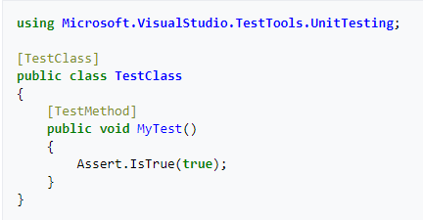
MSTest
Visual Studio Unit Testing Framework.Unit tests created with the unit testing framework can be executed in visual studio or, using MSTest.exe, from a command line.
Elements : Test class, Test method, Assertions
https://en.wikipedia.org/wiki/Visual_Studio_Unit_Testing_Framework
Notes:
© Copyright Showeet.com – Creative & Free PowerPoint Templates

Slide 13
NUnit
Web: https://nunit.org/
NUnit is a unit-testing framework for all .Net languages
Tests can be run from a console runner, within Visual Studio through a Test Adapter,or through 3rd party runners
Tests can be run in parallel
If an assertion fails, the method call does not return and an error is reported
Notes:
© Copyright Showeet.com – Creative & Free PowerPoint Templates

Slide 14
XUnit
XUnit is a collective name for several unit testing frameworks.
It is a part of the .NET foundation and operates under their code of conduct.
New attributes can be created to control tests or default methods can be extended to provide custom functionality.
excellent extensibility
Modern unique style of testing using new fancy tags such as facts and theories.
Notes:
© Copyright Showeet.com – Creative & Free PowerPoint Templates

Slide 15
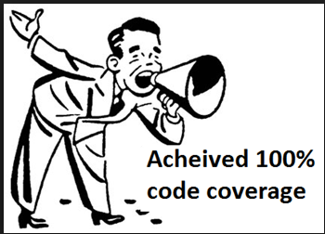
Code Coverage
Code coverage is a measure used to describe the degree to which the source code of a program is executed when a particular test suite runs - (Wikipedia)
A program with high code coverage, measured as a percentage, has lower chance of undetected bugs.
https://www.getfilecloud.com/blog/2015/01/how-to-perform-code-coverage-in-netbeans-ide-for-php-projects/#.XFfTcVxKjIU
Notes:
© Copyright Showeet.com – Creative & Free PowerPoint Templates

Slide 16
Basic coverage criteria
Function coverage - Has each function is covered?
Statement coverage - Has each statement is covered?
Branches coverage - has every branch in the Control flow graph been covered?
Condition coverage (or predicate coverage) - Has each Boolean sub-expression evaluated both to true and false?
Line coverage - how many of lines of source code have been tested
Notes:
© Copyright Showeet.com – Creative & Free PowerPoint Templates

Slide 17
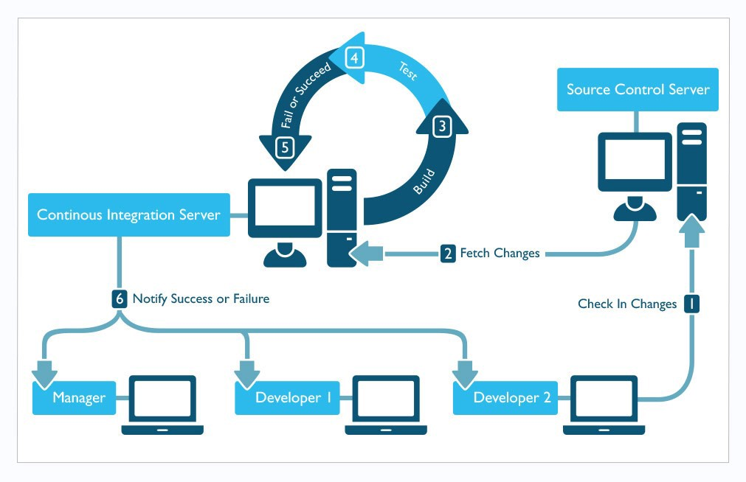
Continuous Integration (CI)
Practice of developers integrate code into a shared repository frequently (preferably several times a day)
Each integration can be verified by automated build and automated test.
Helps to catch errors quickly and locate them more easily
Key principles
revision control
build automation
automated testing
https://journal.missiondata.com/improving-delivery-with-continuous-integration-72a9ffea2117
Notes:
© Copyright Showeet.com – Creative & Free PowerPoint Templates

Slide 18
DEMONSTRATION
21
Notes:
© Copyright Showeet.com – Creative & Free PowerPoint Templates

Slide 19
Summary
18
Notes:
© Copyright Showeet.com – Creative & Free PowerPoint Templates

Slide 20
Summary
Testing is perhaps the most frequently spoken about, but most often ignored aspect of software development.
Unit tests are the most basic level of testing
Unit testing can be done manual or automated
Advantages and disadvantages of unit testing
Unit testing frameworks (MST, NUnit, XUnit)
Code coverage / test coverage
Continuous Integration
Notes:
© Copyright Showeet.com – Creative & Free PowerPoint Templates

Slide 21
Resources
https://redmonk.com/fryan/2018/03/26/a-look-at-unit-testing-frameworks/
https://nunit.org/
https://xunit.github.io/
https://www.youtube.com/watch?v=ub3P8c87cwk
https://en.wikipedia.org/wiki/Code_coverage
Notes:
© Copyright Showeet.com – Creative & Free PowerPoint Templates

Slide 22

Questions and Comments…
https://www.machinedesign.com/community/what-questions-should-you-ask-during-product-lifecycle
Notes:
© Copyright Showeet.com – Creative & Free PowerPoint Templates

Slide 23
Thank You!
Notes:
© Copyright Showeet.com – Creative & Free PowerPoint Templates

